Slide 1
Quality Information, Public Involvement and Transparency in Decision-making Key Principles of European Regulations
Roel Slootweg
SevS consultants

Slide 2
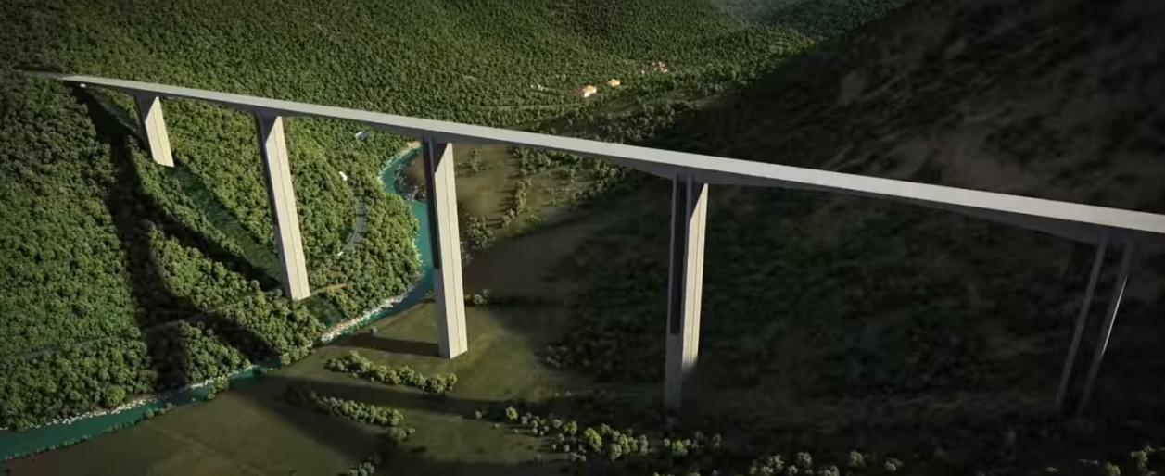
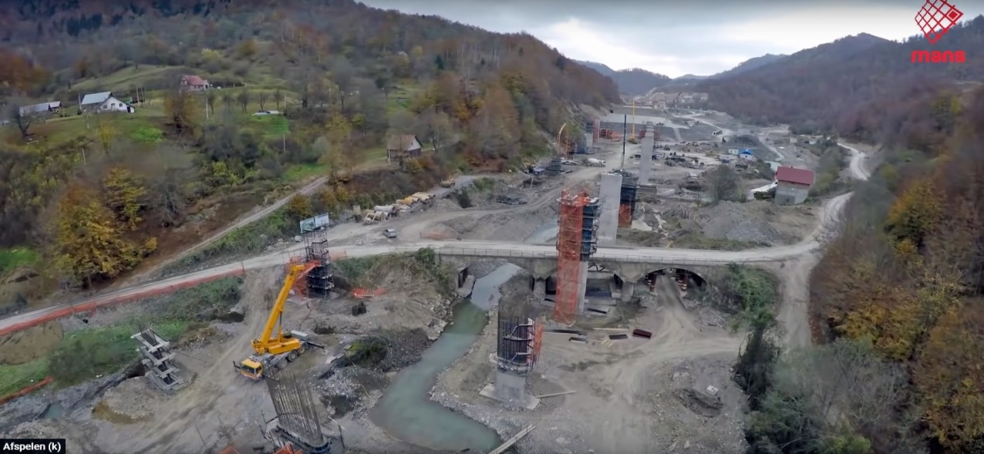
The plan The reality

Slide 3
This presentation
The project
What European regulations would apply?
What consequences would this have?
What can still be done?

Slide 4
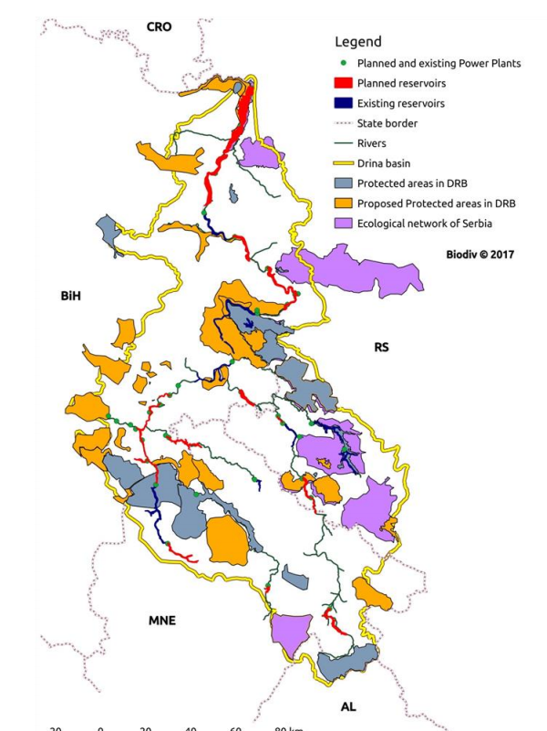
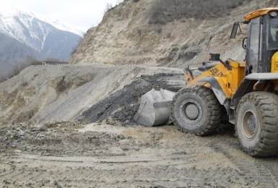
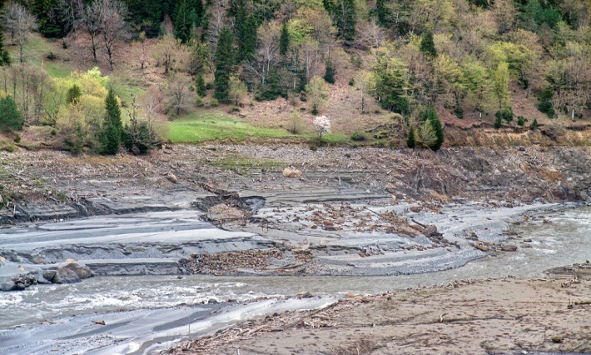
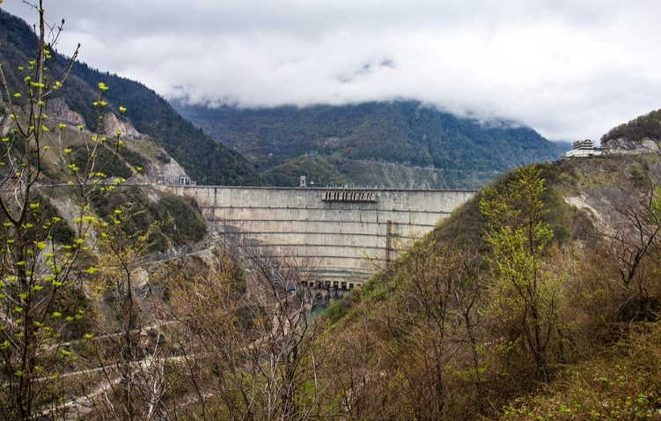
My experience: erosion control and environmental management makes economic and biological sense. In: Upper Svanetti world heritage site & Enguri HP dam, Georgia
Drina river basin
(World Bank 2017)

Slide 5
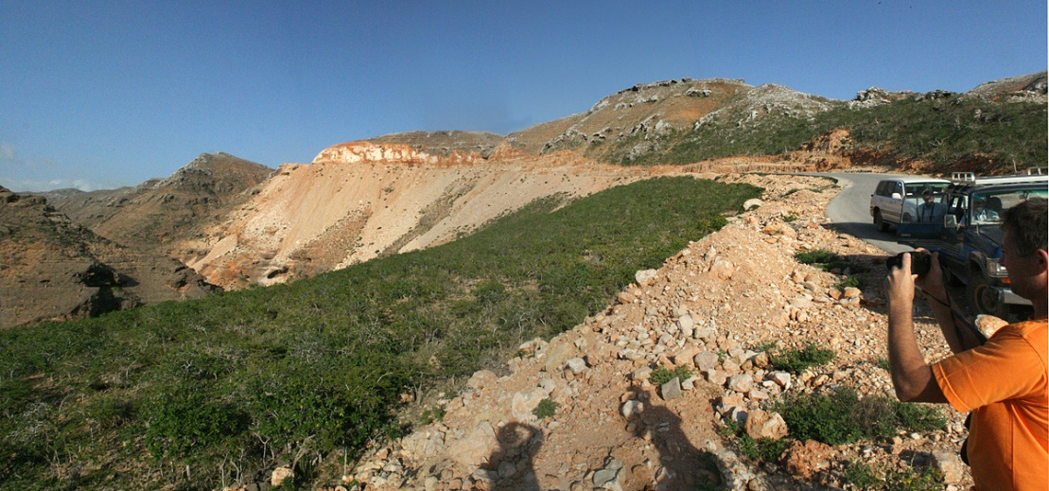
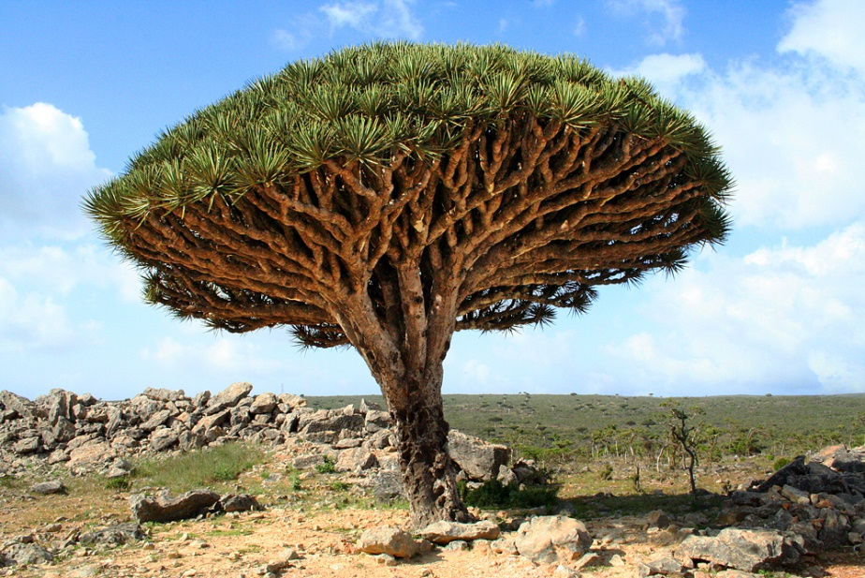
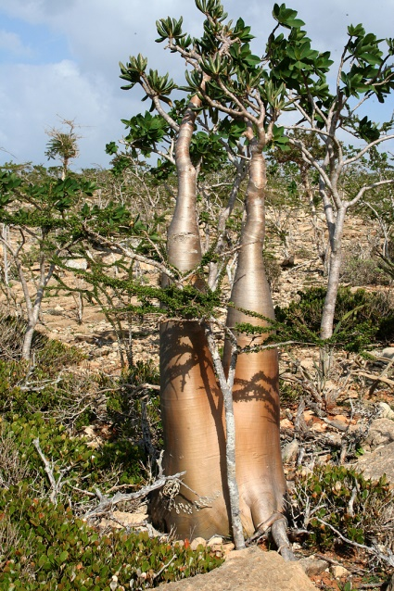
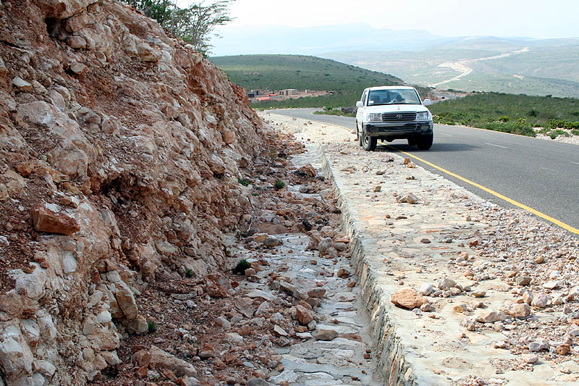
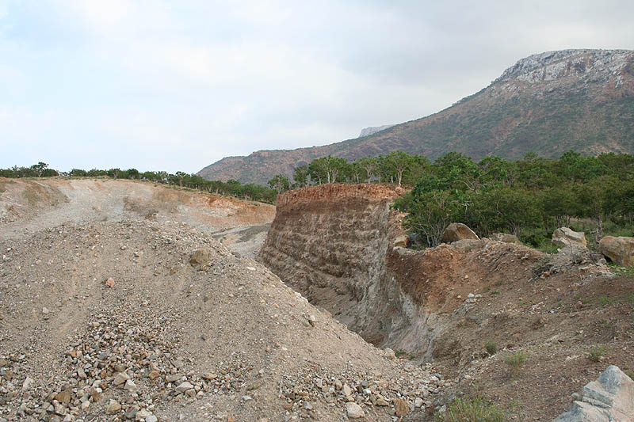

Slide 6
Tara River: A Serious Case
Call from EU parliament (2018):
Timely and accurate information on the impact of highway construction on Tara river, to be made available to a wide public
EU Montenegro Report (2019):
Urgent to improve ecological value of potential Natura 2000 sites;
prevent impacts of construction on Tara River (Bar-Boljare highway)
Request from World Heritage Committee (2019):
Severe impacts on Tara river from road construction
downstream impacts on the Outstanding Universal Value of Durmitor
endangered Danube Salmon

Slide 7
From the project website
Implementation of the Bar – Boljare highway project is stipulated under the Detailed Spatial Plan of the Bar-Boljare highway (2008).

Slide 8
What European Regulations apply?
EIA Directive
=> Bar-Boljare highway
Habitat & Birds Directives
=> Durmitor World Heritage Site and other downstream protected areas
Water Framework Directive
=> affected river basin; is there a river management plan?
SEA Directive
=> Spatial Plan of the Bar-Boljare highway (2008)

Slide 9
Steps in EIA
Screening: annex I, 7b/c roads = EIA required
Scoping: issues + public consultation => guidelines for study
EIA study: Report + Env. Mgmt & Monitoring Plan
Review : technical + public review
Decision + motivation
Monitoring

Slide 10
EIA Directive Art 6: public participation
Ensure effective public participation in the decision-making procedures;
Provide a time schedule for comments or questions and times / places where relevant information will be made available;
Make available the EIA report (including EMMP);
Consultation shall not be shorter than 30 days.

Slide 11
EIA Directive – cont’d
Art 7: EIA in transboundary situations (Espoo convention)
Art 9: authority informs public on decision and motivation; This includes a summary of consultations.
Make sure the public has the right to a review procedure before a court.
Aarhus convention on access to information, public participation in decision-making and access to justice in environmental issues in the EU applies to the entire procedure.

Slide 12
Transboundary impacts
UNECE Convention on EIA in Transboundary context (Espoo convention):
Address transboundary impact in ESIA
Define geograpical area likely to be affected
Principles:
Prevent, reduce and control transboundary impacts
Early stakeholder identification and engagement
Prepare a cadastre of downstream water uses.

Slide 13
Habitat/Birds Directives (Natura 2000)
Appropriate Assessment (art. 6.3):
Projects have external effects on protected areas
For Tara => downstream effects
Projects with negative impacts cannot be approved…
… unless there is NO alternative and reasons of overriding public interest. Then compensation required prior to project implementation.
Anyone can complain to Aarhus Compliance committee and/or EU Court of Justice

Slide 14
Water Framework Directive (WFD)
River basin management plan required
Development projects have to make sure that natural water bodies should achieve a good ecological status
If a project compromises the good status, an assessment of conditions is needed
If the project cannot fullfil the WFD conditions, the project cannot be authorised.

Slide 15
SEA / Cumulative impacts
Strategic Environmental Assessment required for plans and programmes, such as:
River basin management plans (as required by Water Framework Directive)
Spatial plans (such as Spatial Plan for Bar-Boljare highway, 2008).
Principles of transparency (Aarhus) also apply to SEA Directive

Slide 16
EU Montenegro 2019 Report
Need to strengthen transparency and stakeholders' participation
Challenges in understanding the role of free media
Growing trend of public institutions declaring information as classified
Efforts are needed to ensure meaningful consultations with civil society actors
These are fundamental values to all European procedures!

Slide 17
What can be done now ?
Avoid/mitigate/compensate damage
sediment & pollution control; landscaping and revegetation; animal passages; rehabilitation of quarries; etc.…
… in consultation with stakeholders in the river basin.
gov’ments, NGOs, private sector.
Inform public and Int. Organisations on proposed measures and report on it …
… by providing open access to monitoring plan and data.

Slide 18
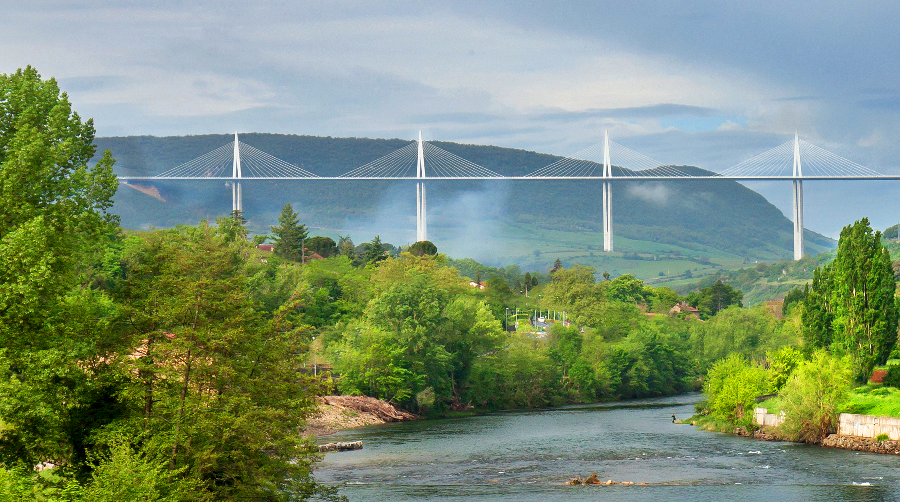
Infrastructure can be built with respect for people and the environment

Slide 19
Aarhus Convention (1998)
The United Nations Economic Commission for Europe (UNECE) Convention on Access to Information, Public Participation in Decision-Making and Access to Justice in Environmental Matters:
Rights of the public (individuals and their associations)
to receive environmental information that is held by public authorities ("access to environmental information"):
the right to participate in environmental decision-making ("public participation in environmental decision-making");
the right to review procedures to challenge public decisions ("access to justice").

Slide 20
Aarhus Convention (1998)
The United Nations Economic Commission for Europe (UNECE) Convention on Access to Information, Public Participation in Decision-Making and Access to Justice in Environmental Matters:
Rights of the public (individuals and their associations)
to receive environmental information that is held by public authorities ("access to environmental information"): This can include information on the state of the environment, but also on policies or measures taken, or on the state of human health and safety where this can be affected by the state of the environment. Applicants are entitled to obtain this information within one month of the request and without having to say why they require it. In addition, public authorities are obliged, under the Convention, to actively disseminate environmental information in their possession;
the right to participate in environmental decision-making. Arrangements are to be made by public authorities to enable the public affected and environmental non-governmental organisations to comment on, for example, proposals for projects affecting the environment, or plans and programmes relating to the environment, these comments to be taken into due account in decision-making, and information to be provided on the final decisions and the reasons for it ("public participation in environmental decision-making");
the right to review procedures to challenge public decisions that have been made without respecting the two aforementioned rights or environmental law in general ("access to justice").

